Slide 1

Rubik’s Cube Puzzle Game
Group Members: Ramsey Foster, Nico Escobedo, Luca Ficano

Slide 2
Agenda
Agenda Item #1
Motivation
Agenda Item #2
Main Methods Used
Agenda Item #3
The OOP Fundamentals
Agenda Item #4
Images and Demo

Slide 3
Introduction
Why We Built It
Interactive Learning: Create an engaging platform for puzzle enthusiasts to practice and master Rubik’s Cube solving, blending fun with skill-building.
Inspired by Chess.com: Modeled after Chess.com’s random checkmate puzzles, our simulator generates randomized cube scrambles across three difficulty levels (Beginner, Intermediate, Hard), challenging players to solve unique puzzles each time.

Slide 4
Main Methods
TurnX, TurnY, TurnZ, TurnMiddleX, TurnMiddleY, TurnMiddleZ
The Rubik’s Cube rotates faces using turnX, turnY, or turnZ, where turnX (Right face) fixes x and swaps y and z (e.g., clockwise: (x, y, z) to (x, -z, y)). Keys like r/R trigger these 90-degree turns, updating cubie positions and orientations.
applyScramble
The applyScramble function generates a random sequence of moves (e.g., U, R') based on difficulty (2, 15, or 25 moves) and applies them using turnX, turnY, or turnZ, shuffling cubie positions and orientations to create a solvable puzzle.
checkSolved
The checkSolved function verifies if the cube is solved by checking that all nine minifaces on each face Up: Yellow match their expected color, setting isSolved to true if every face is uniform.

Slide 5
OOP Fundamentals
Encapsulation: Private fields like cube in RubiksCube and normal in Face are safeguarded, accessible only through methods like turnX or getNormal, ensuring controlled state changes.
Abstraction: Complex operations such as rotating faces and scrambling are simplified into methods like applyScramble and checkSolved, hiding details like coordinate math or color checks.
Inheritance: RubiksCubeApp extends JavaFX’s Application to build the UI, reusing its framework for stage setup.
Polymorphism: RubiksCube implements GLEventListener and KeyListener, allowing JOGL to call methods like display or keyPressed flexibly for rendering and input.

Slide 6
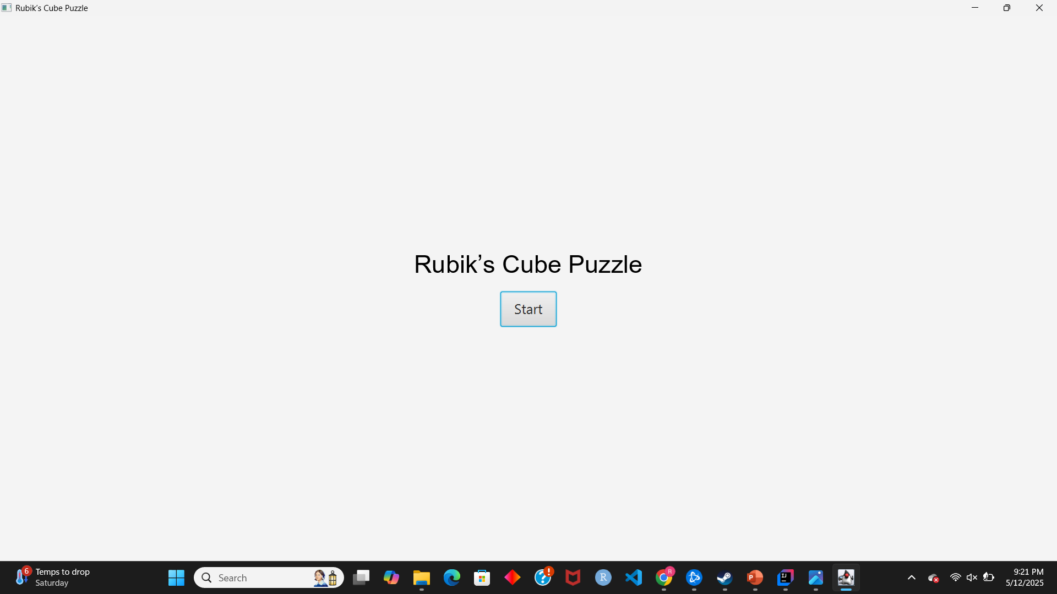
Photos and Demo
When running the code we are greeted with the menu to begin the Game

Slide 7
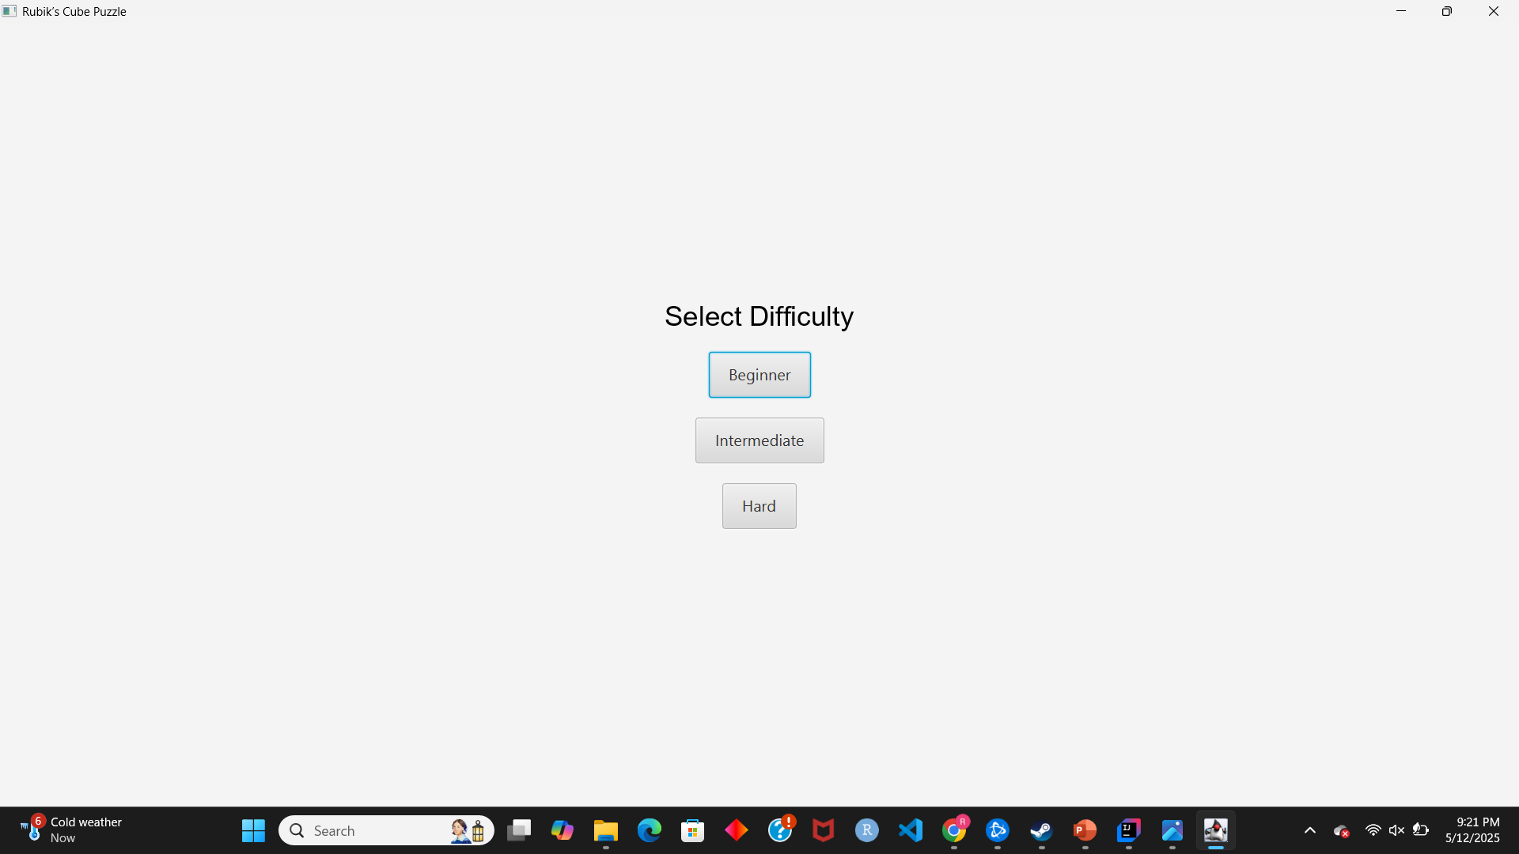
Photos and Demo
After pressing the start button we are given a difficulty level with Beginner that takes 2 moves to finish, Intermediate that takes 15 moves to finish and Hard that takes 25 moves.

Slide 8
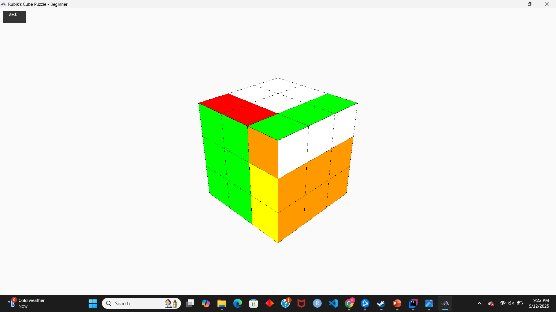
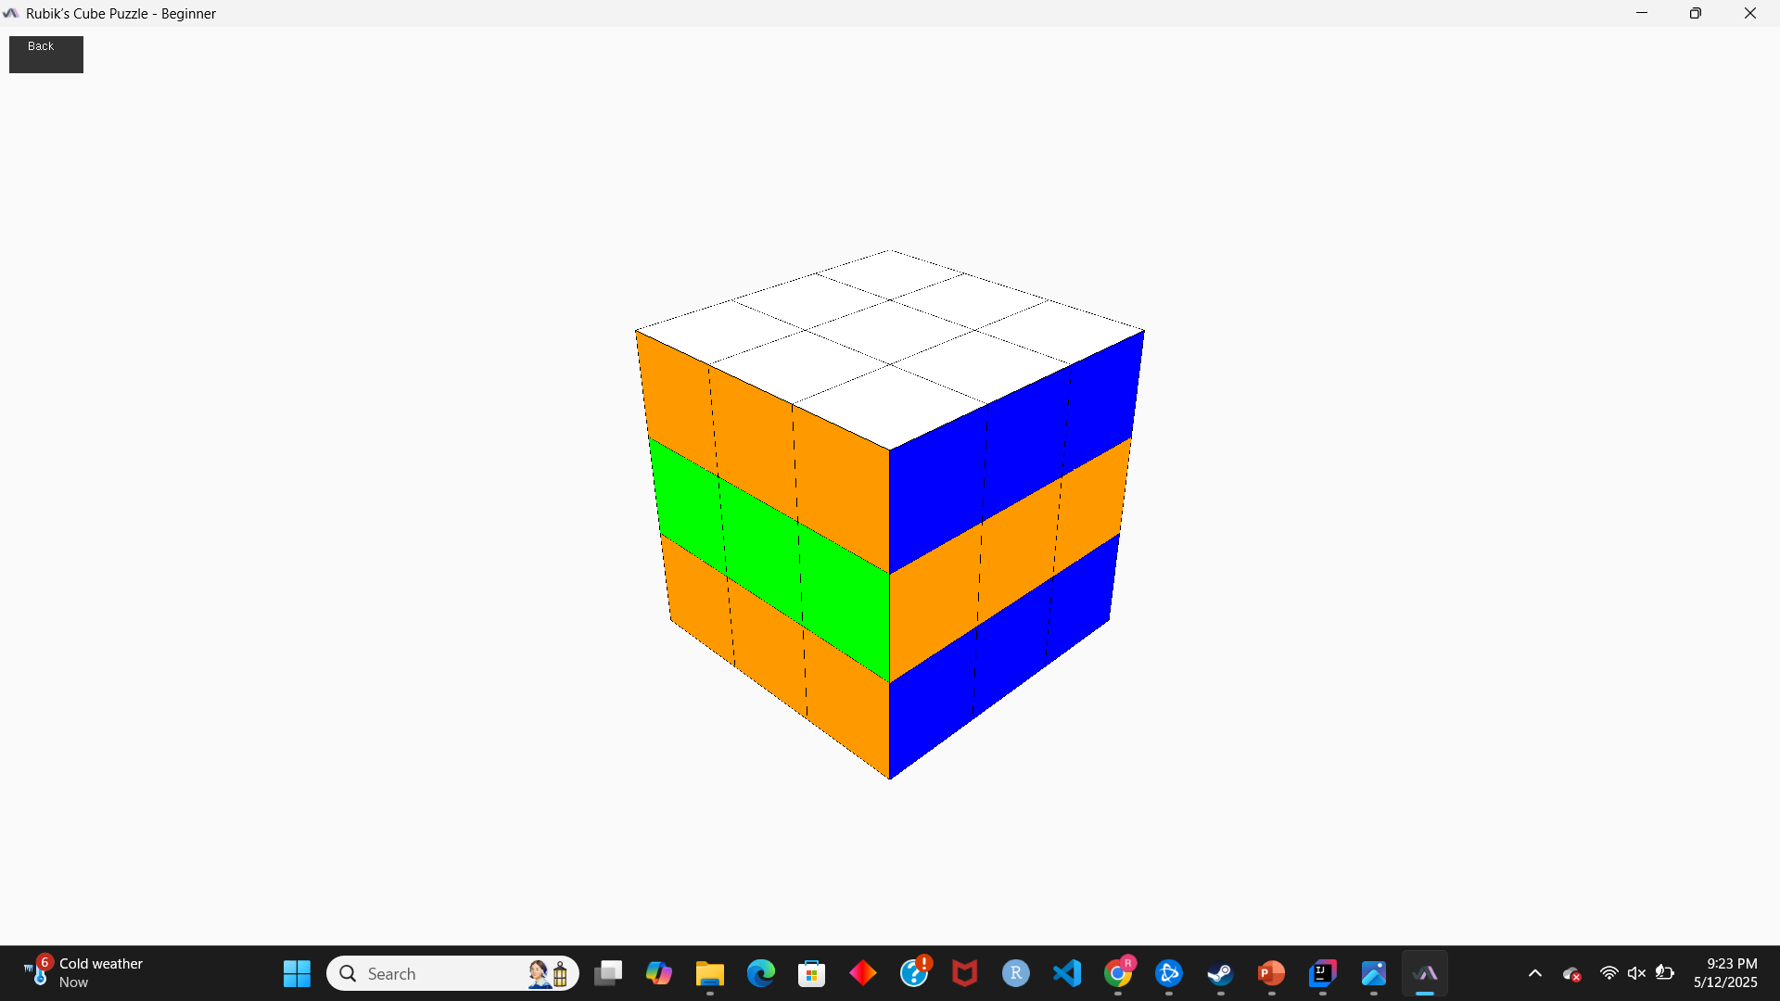
Photos and Demo

Slide 9
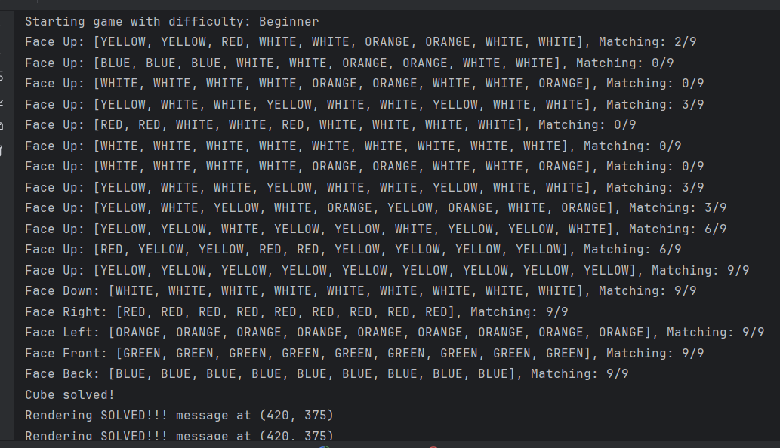
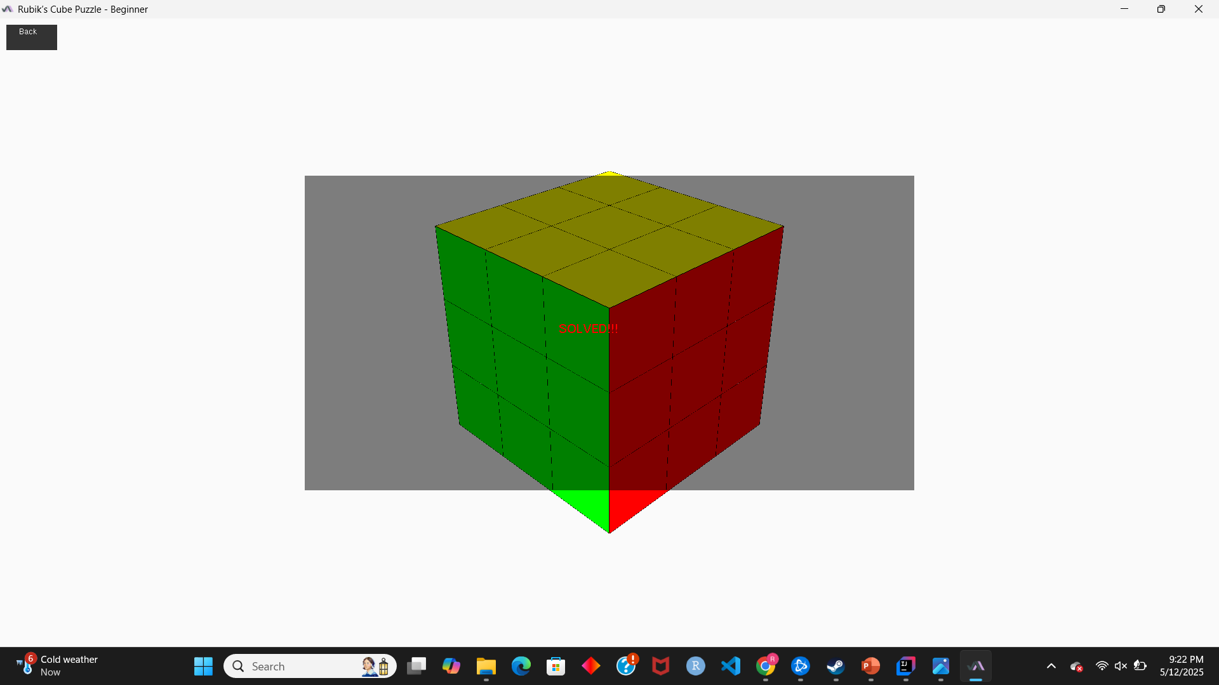
Photos and Demo

Slide 10

DEMO

